Slide 1
The inbound purchasing inventory routing problem with perishable products
Daniel Cuellar-Usaquén
Camilo Gómez, David Álvarez-Martínez
Marlin Ulmer
Otto-von-guericke universität Magdeburg
1
1
Notes:
Good afternoon, my name is Daniel Cuellar. I’m from Bogota Colombia.
I ending the second year of my Phd in Los Andes university.
The title of the presentation is “The inbound purchasing inventory routing problem with perishable products”.

Slide 2
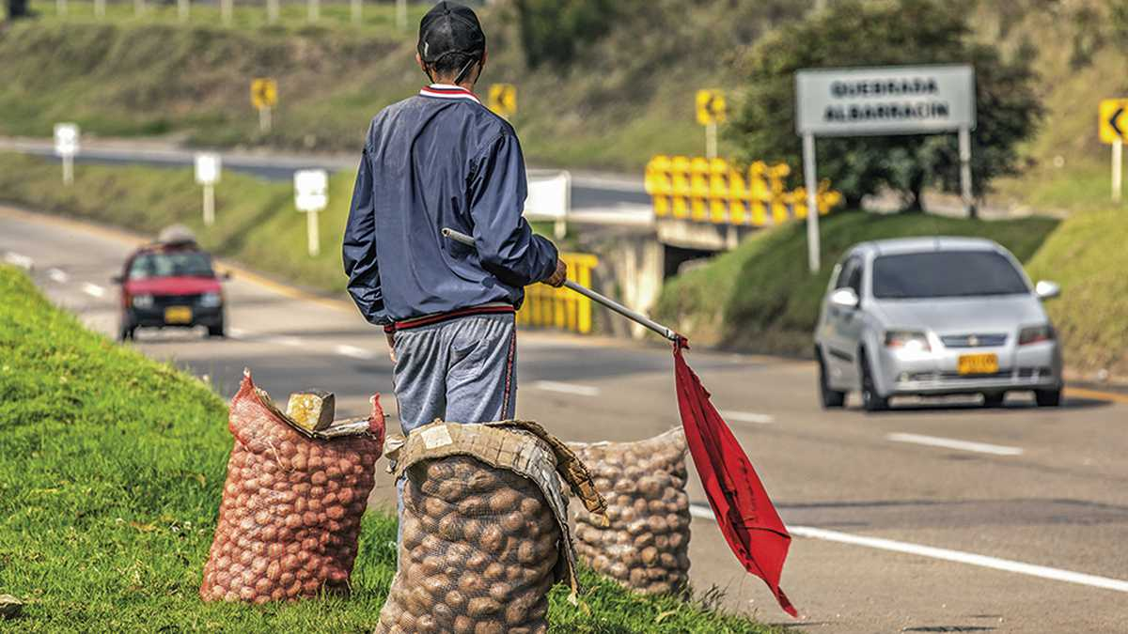
Small farmers with limited distribution capacity
2016 Colombian peace agreement ended a 60-year internal war.
Small farmers have little or no distribution capacity, limiting their participation in supply chains.
Most of the income remains in the different links of the chain due to the large number of intermediaries.
Companies with high horizontal integration allow to reduce this gap between small farmers and customers.
Notes:
Our motivation is born with small farmers. In Colombia it is common to see that
Currently, it has been seen that …

Slide 3

E-commerce platforms as bridges
Colombian company that is present in multiple countries as
E-commerce platforms as bridges between producers and consumers
Farmers
Warehouses
Customers
Notes:
E-commerce patforms like Kimbers or Farmdrop can increase the participation of small farmers in the agri-food supply chains.
They allow to small farmers access to well stablish markets like hotels, restaurant and households though warehouse that distribute the product to customers.

Slide 4
E-commerce platforms as bridges
Colombian company that is present in multiple countries as
Two-echelon supply chains
Farmers
Warehouses
Customers
Notes:
This type of structure ….

Slide 5
E-commerce platforms as bridges
Colombian company that is present in multiple countries as
Outbound logistic – Last mile
Farmers
Warehouses
Customers

Slide 6
E-commerce platforms as bridges
Colombian company that is present in multiple countries as
Inbound logistic – First mile
Farmers
Warehouses
Customers

Slide 7
E-commerce platforms as bridges
Colombian company that is present in multiple countries as
Inbound logistic – First mile
Outbound logistic – Last mile
Farmers
Warehouses
Customers
Notes:
The information flow between two echelons is connected throught the warehouse where all replenishment and distribution planning falls.
The last mile echelon is one of the most studied problem because its complexity. However, in the last years, The first mile has attracted a lot of interest in the literature as the aim is to make supply chains sustainable for all stakeholders in the chain.
In this work we will focus in the first mile.

Slide 8
E-commerce platforms as bridges
Colombian company that is present in multiple countries as
Inbound logistic – First mile
Farmers
Warehouses
Customers
Notes:
The information flow between two echelons is connected throught the warehouse where all replenishment and distribution planning falls.
The last mile echelon is one of the most studied problem because its complexity. However, in the last years, The first mile has attracted a lot of interest in the literature as the aim is to make supply chains sustainable for all stakeholders in the chain.
In this work we will focus in the first mile.

Slide 9




Problem description
Suppliers
Warehouse
Customers
Products\Days | Forecasted product demand (units) |  |  |  |  | P
 | 1 | 2 | 3 | 4 | 5
 | 31 | 37 | 34 | 35 | 33 | 3
 | 40 | 23 | 33 | 30 | 35 | 4
 | 40 | 48 | 55 | 70 | 63 | 3
1
6
2
P: Maximum number of periods that a product can remain in storage
5
The decisions to make at each period are:
Selection of suppliers
Quantity to be purchased
Quantity to hold in inventory
Order in which each vehicle visits suppliers (i.e., the routes).
Inventory management
4
3

Slide 10


Problem description
Suppliers
Warehouse
Customers
Products\Days | Forecasted product demand (units) |  |  |  |  | P
 | 1 | 2 | 3 | 4 | 5
 | 31 | 37 | 34 | 35 | 33 | 3
 | 40 | 23 | 33 | 30 | 35 | 4
 | 40 | 48 | 55 | 70 | 63 | 3
1
Day 4
6
2
5
Procurement plan
Day 1
Day 4
Day 1
Inventory management
102
68
4
96
65
3
143
133
Split pickups are not allowed

Slide 11
Problem description
Suppliers
Warehouse
Customers
Products\Days | Forecasted product demand\ Inventory levels (units) |  |  |  |  | P
 | 1 | 2 | 3 | 4 | 5
 | 31\71 | 37\34 | 34\0 | 35\33 | 33\0 | 3
 | 40\56 | 23\33 | 33\0 | 30\35 | 35\0 | 4
 | 40\103 | 48\55 | 55\0 | 70\63 | 63\0 | 3
1
Day 4
6
2
5
Procurement plan
Day 1
Day 4
Day 1
Inventory management
102
68
4
96
65
3
143
133
Split pickups are not allowed

Slide 12
Problem description
Objective:
The warehouse needs to simultaneously minimize the purchasing, inventory, and transportation costs for the entire planning horizon, considering the deterministic version of the problem.

Slide 13
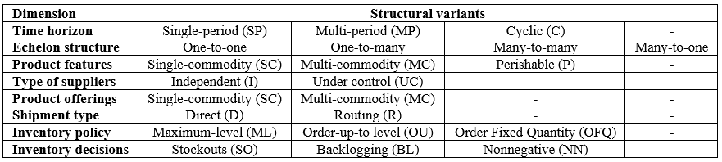
State-of-the-art
Classification of inbound inventory routing problems
Adapted and extended from Gruler et al., 2020
Notes:
Well, doing the state-of-the-art we found a classification for the problem that cosider inventory and routing decisions. However, we adapt and added three charactersitic more according to inbound inventory routing problems.
Explain the three categories
It’s very important hightlight the supplier characteristic because in the literatura is comom to reduce the inbound logictis problem to direct shipment and single commodity from the suppliers. Which reduces the participation of the farmers.

Slide 14
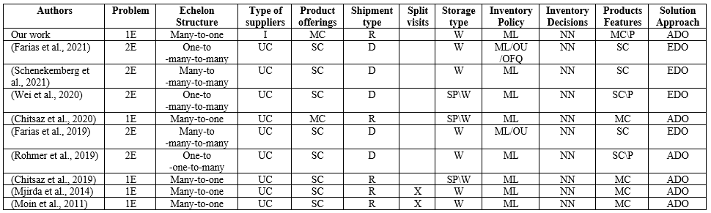
State-of-the-art
Authors that solve inbound inventory routing problems
Notes:
With this classification we found some authors that solve inbound IRP however, no of them Works with independet suppliers. It is commom to find that it is posible to manage the suppliers inventory or the cost to purchase the products is not considered.
In our work, we must consider the product purchase price and we can't to manage the capacities and inventory in the farmers. This presents a strong contribution of our work.

Slide 15
State-of-the-art
MVTPPs can be classified according to four categories referring to the available supply, demand, vehicle capacity, and purchasing policy.
Available supply
Restricted: if the available quantity is less than the product demand
Unrestricted: if the available quantity is not less than the corresponding demand
Demand
Unitary: if the demand for each product is one
General: otherwise
Multi-Vehicle Traveling purchaser problem

Slide 16
State-of-the-art
MVTPPs can be classified according to four categories referring to the available supply, demand, vehicle capacity, and purchasing policy.
Vehicles
Capacitated: meaning that the given capacity can become binding
Uncapacitated: otherwise
purchasing policy
Split (purchases): if the same product can be purchased multiple times at the same supplier
Non-split (purchases): otherwise
Multi-Vehicle Traveling purchaser problem

Slide 17
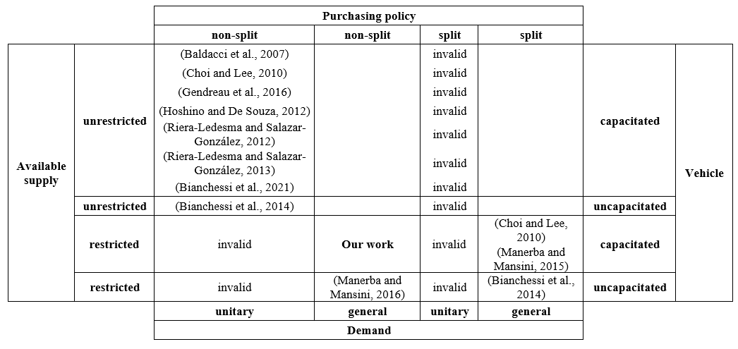
State-of-the-art
Multi-Vehicle Traveling purchaser problem

Slide 18
Methodology
Exact approach
Matheuristic approach

Slide 19
Methodology
Exact approach
Matheuristic approach

Slide 20





Notation
$$M:$$
Set of suppliers (farmers)
$$K:$$
Set of products
$$T:$$
Set of periods
$$d_{kt}:$$
Demand of the product $k$ at the period $t$
$$M_{kt}:$$
Subset of suppliers offering product $k$ at time $t$

Slide 21





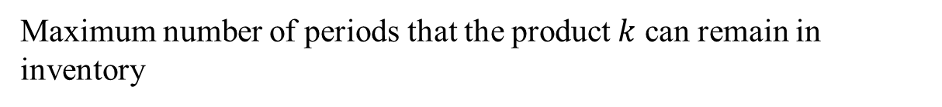

Notation
$$O_{k}:$$
Maximum number of periods that the product $k$ can remain in inventory
$$q_{ikt}:$$
Quantity available of the product $k$ in from supplier $i$ at the period $t$
$$p_{ikt}:$$
Price of the product $k$ from supplier $i$ at the period $t$
$$h_{kt}:$$
Holding cost of product $k$ at the time $t$
$$c_{ij}:$$
Transportation cost between nodes $i$ and $j$
$$Q:$$
Vehicle capacity

Slide 22
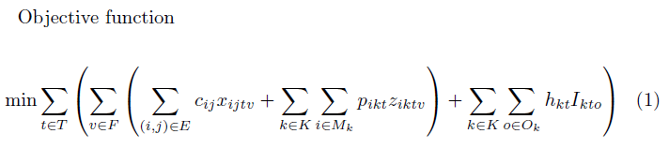
Exact approach
Routing cost
Inventory cost
Purchase cost

Slide 23
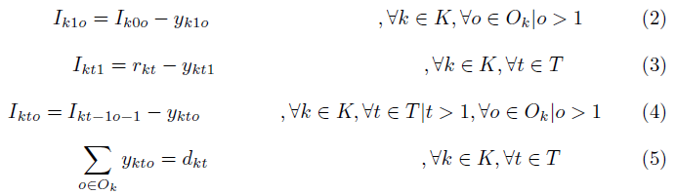
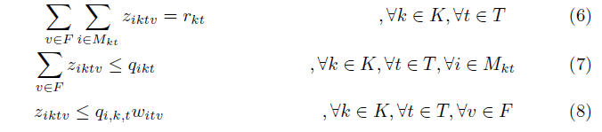
Exact approach
Inventory constraints
Purchase constraints
Notes:
Hightlight the perisahble modeling

Slide 24
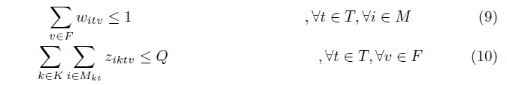
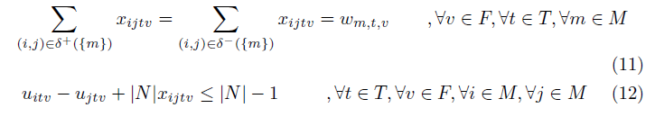
Exact approach
Non-split constraints
Routing constraints

Slide 25
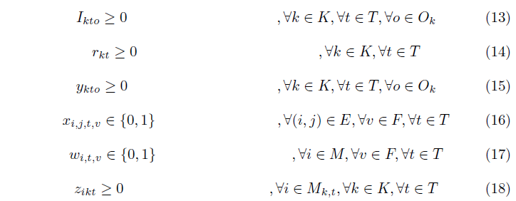
Exact approach
Variables domain

Slide 26
Methodology
Exact approach
Matheuristic approach
Notes:
Since the problem is NP-hard it is interesting to have but it’s not practical.
So we proposed a matheheuristic matheheursitic approach

Slide 27
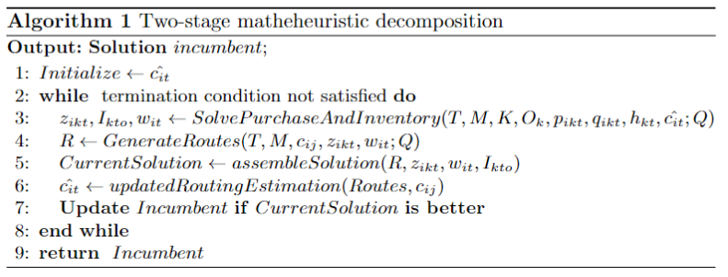
Matheuristic approach

Slide 28
Matheuristic approach - first stage

Slide 29

First stage – purchase and inventory decisions
Subject to:
Inventory constraints (2 – 5)
Purchase constraints (6 – 8)
Non-split constraints (9 – 10)
Notes:
Poner bloques sin poner las ecuaciones

Slide 30
Matheuristic approach - second stage

Slide 31
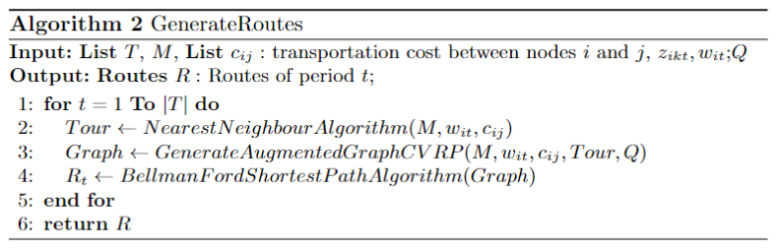
Second stage – routing decisions

Slide 32
Matheuristic approach – assemble solution

Slide 33
Matheuristic approach – routing approximation

Slide 34



Update routing estimation
Initialization ($iter = 0$)
$${{\hat{c_{it}}}^{0}=c}_{0i}+c_{i0}, ∀i∈M, ∀t∈T$$
Updated next iterations (i$ter+=1$)
If supplier $i$ is part of a route at period $t$
$${{\hat{c_{it}}}^{iter}=({\hat{c_{it}}}^{iter−1}+c}_{i_{p}i}+c_{ii_{s}}−c_{i_{p}i_{s}})/2, ∀i∈R_{t} , ∀t∈T$$
0
2
5
3
0

Slide 35
Update routing estimation
Initialization ($iter = 0$)
$${{\hat{c_{it}}}^{0}=c}_{0i}+c_{i0}, ∀i∈M, ∀t∈T$$
Updated next iterations (i$ter+=1$)
If supplier $i$ is not part of a route at period $t$
$${{\hat{c_{it}}}^{iter}=({\hat{c_{it}}}^{iter−1}+c}_{BestInsertion})/2, ∀i∉R_{t} , ∀t∈T$$
0
3
5
0
1

Slide 36
Matheuristic approach – termination condition

Slide 37
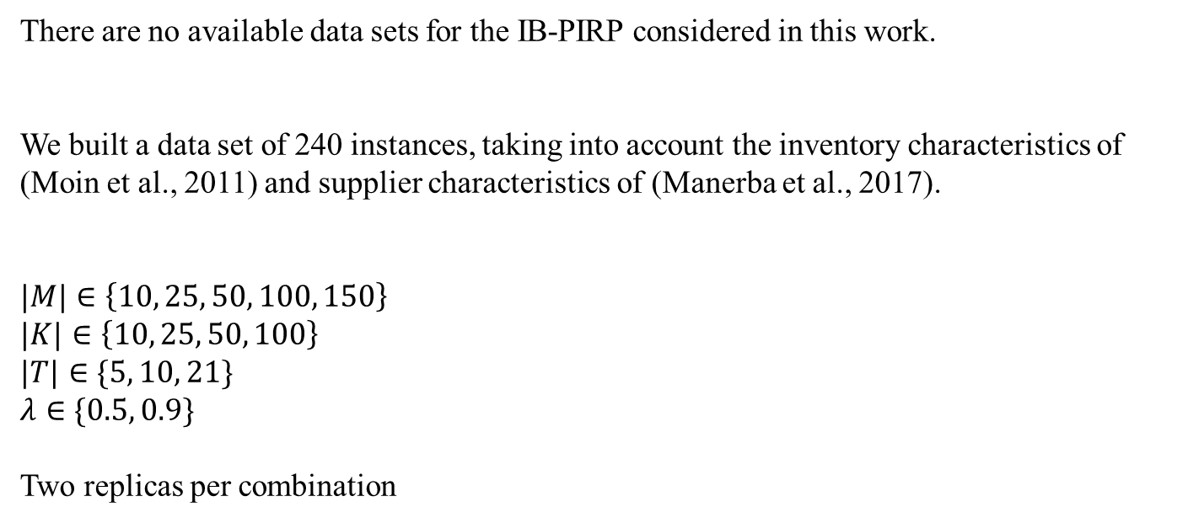
Instances
There are no available data sets for the IB-PIRP considered in this work.
We built a data set of 240 instances, taking into account the inventory characteristics of (Moin et al., 2011) and supplier characteristics of (Manerba et al., 2017).
$$|M|∈\left\{10, 25, 50, 100, 150\right\}$$
$$|K|∈\left\{10, 25, 50, 100\right\}$$
$$|T|∈\{5, 10, 21\}$$
$$λ∈\{0.5, 0.9\}$$
Two replicas per combination
$$λ →1 \left(demand can be satisfied with few suppliers\right)$$
$$λ →0 \left(many suppliers are needed to satisfy demand\right)$$

Slide 38
Experimental setup
Python 3.7
Gurobi 9.1.1
2.11 GHz processor
16GB of RAM

Slide 39
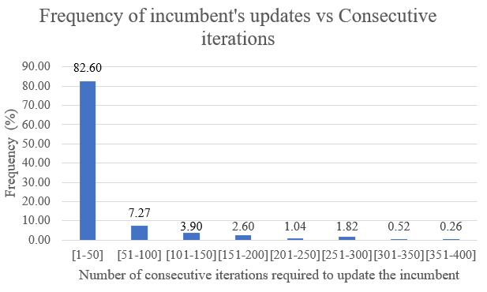
Incumbent's convergence behavior
Notes:
Arreglar la imagen con los rangos adecuados.

Slide 40
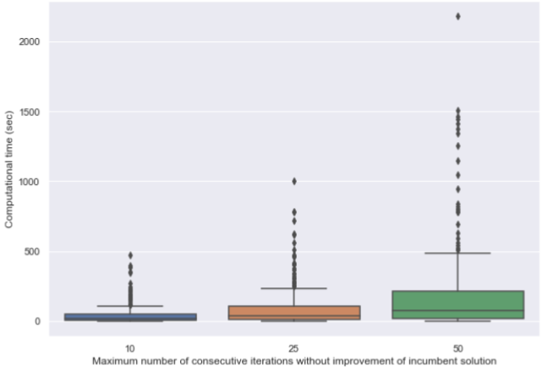
Tuning the stopping criteria
(% instances with best solution, % run time)
(77%/23%) (88%/49%) (100%, 100%)
Computational time (sec)
Maximum number of consecutive iterations without improvement of incumbent solution

Slide 41
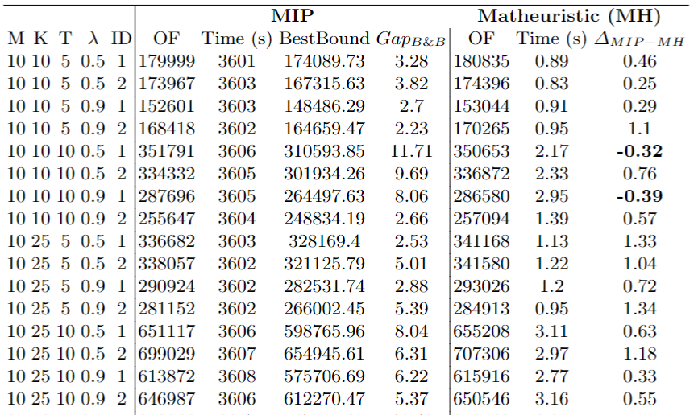
How good are the solutions with respect to the optimum?
Notes:
Actualizar

Slide 42
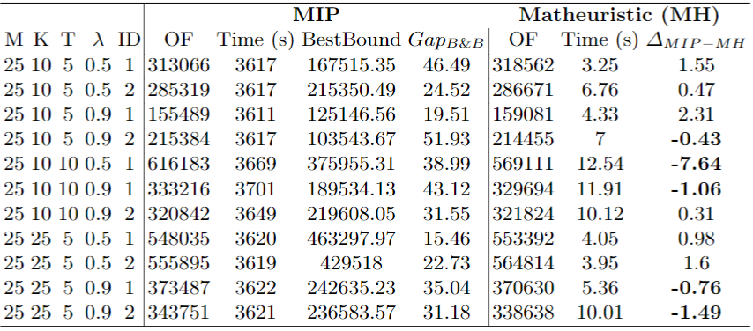
How good are the solutions with respect to the optimum?

Slide 43
How good are the solutions with respect to the optimum?
MIP can only resolve small instances. It found an integer solution in 27 out of 240 instances in a time limit of one hour.
Percentual differences in favor of the exact approach are in the [0.25, 2.31] ranges and in favor of matheuristic are in the [0.32, 7.64] ranges.

Slide 44
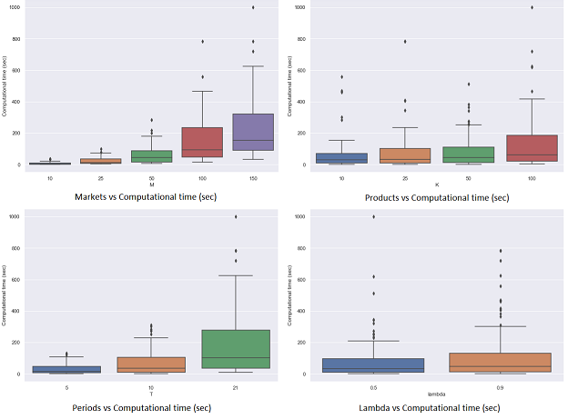
Computational performance
Computational time (sec)
Markets vs Computational time (sec) Products vs Computational time (sec)
Computational time (sec)
Periods vs Computational time (sec) Lambda vs Computational time (sec)

Slide 45
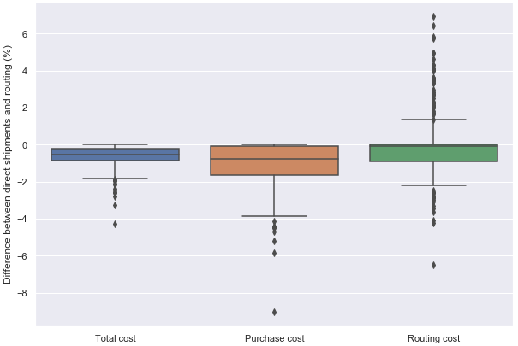

Baseline comparison
Does routing to suppliers generate a higher profit versus direct shipments?
Direct shipment vs Routing
Direct shipments
$Δ_{Routing−Direct}$
Routing

Slide 46
Implementation
The implementation of the proposed methodology presents difficulties since the operation is divided into different areas (purchasing, transportation, dispatch, forecasting).
The information arrives at different times, generating difficulties in decision making; however, the results obtained have convinced top management of the implementation of this model.

Slide 47
Conclusions
We presented a matheuristic decomposition approach for the inbound purchasing inventory routing problem, responding to challenges of the agri-food supply chain in the context of south america e-commerce.
The key contribution is the integration of inventory decisions to satisfy a demand of perishable products with procurement decisions, including a selection of supplier for each product and routing decisions
As a first step, the proposed matheuristic approach obtains good quality solutions within reasonable computation times.
The present results provide initial confirmation of the potential for considering small farmers in agricultural supply chains.

Slide 48
Future work
The next steps of the research are:
Accelerate the exact approach (B&C).
Develop a pure metaheuristic approach (that does not depend on a solver).
Formulate the stochastic dynamic version of the problem (stochastic demand, product prices, availability at the supplier and perishability).

Slide 49


Questions
Thanks!
dh.cuellar@uniandes.edu.co
gomez.ch@uniandes.edu.co
d.alvarezm@uniandes.edu.co
http://copa.uniandes.edu.co
Notes:
Well. That was my presentation thank you very much. If anyone has questions, now is the time .

